Slide 1
Prediction of New user Bookings of Airbnb
Group -14

Slide 2

Context & Objective
Airbnb, one of the world’s largest platforms for vacation rentals and tourism activities, wants to know where a new user books their next vacation plan.
By accurately predicting where a new user is likely going to book their travel destination, Airbnb can customize their travel experience, and better forecast the demand.
We can use supervised machine learning models such as classification to answer the business needs of Airbnb.

Slide 3
Data Description
Our dataset consists of 213k records with 15 independent variables and 1 dependent variable(outcome) which is the destination country.
The independent variables include wide range of user characteristics such as gender, age, date account created, signup method, affiliate channel, affiliate provider, signup app etc.

Slide 4
Feature Selection & Preprocessing
We observed that the raw data has many missing and unknown values with inconsistent formats that need to be cleaned.
Also we saw that the raw data has few redundant variables that may not affect the user’s choice of travel destination.
Hence we decided to do the data cleaning and feature selection procedure to work on clean and most relevant data.
Feature selection first?
Or
Data processing first?

Slide 5
Feature Selection & Preprocessing
We decided to do the feature selection before data cleaning so that we don’t lose too many records while cleaning columns that are not relevant for our model.
This way we managed to have 108k records to train and test our model.
We have selected the features based on correlation with the dependent variable and on judgement
We have also engineered feature - age to reduce the dimensions and retain the overall data structure.
Features selected:
Age
Gender
Language preference
Signup app
Signup method
Affiliate provider
Affiliate channel

Slide 6
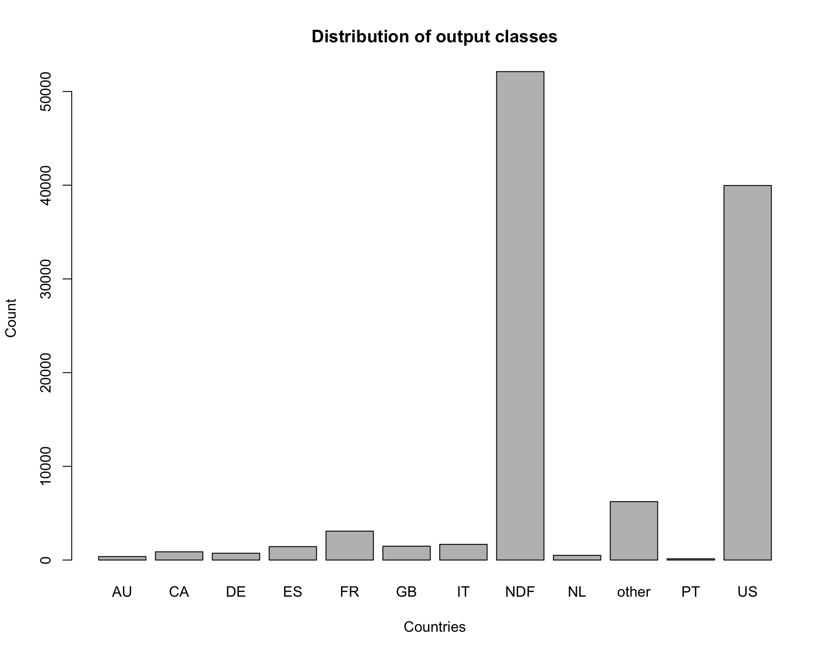
Challenges
We saw that we need to predict one of 12 possible classes.
Also the classes are highly unbalanced as can be seen in the graph.
It will be challenging to train a single model on such an unbalanced data with too many prediction classes.

Slide 7
Solutions
Level -1
Is the user going to make a booking or not?
It will be impractical to apply single blanket model on the whole data as it may lead to either over fitting or improper generalisation to new data(low accuracy).
Hence we decided apply different customised models at different levels of decision points to improve the overall accuracy and generalization of model.
Level -1
Is the user choosing US or Non-US destination given he is going to book?
Level -1
Level -2
Level -1
Which Non-US country is the user going to choose given he books for a Non-US country?
Level -3

Slide 8
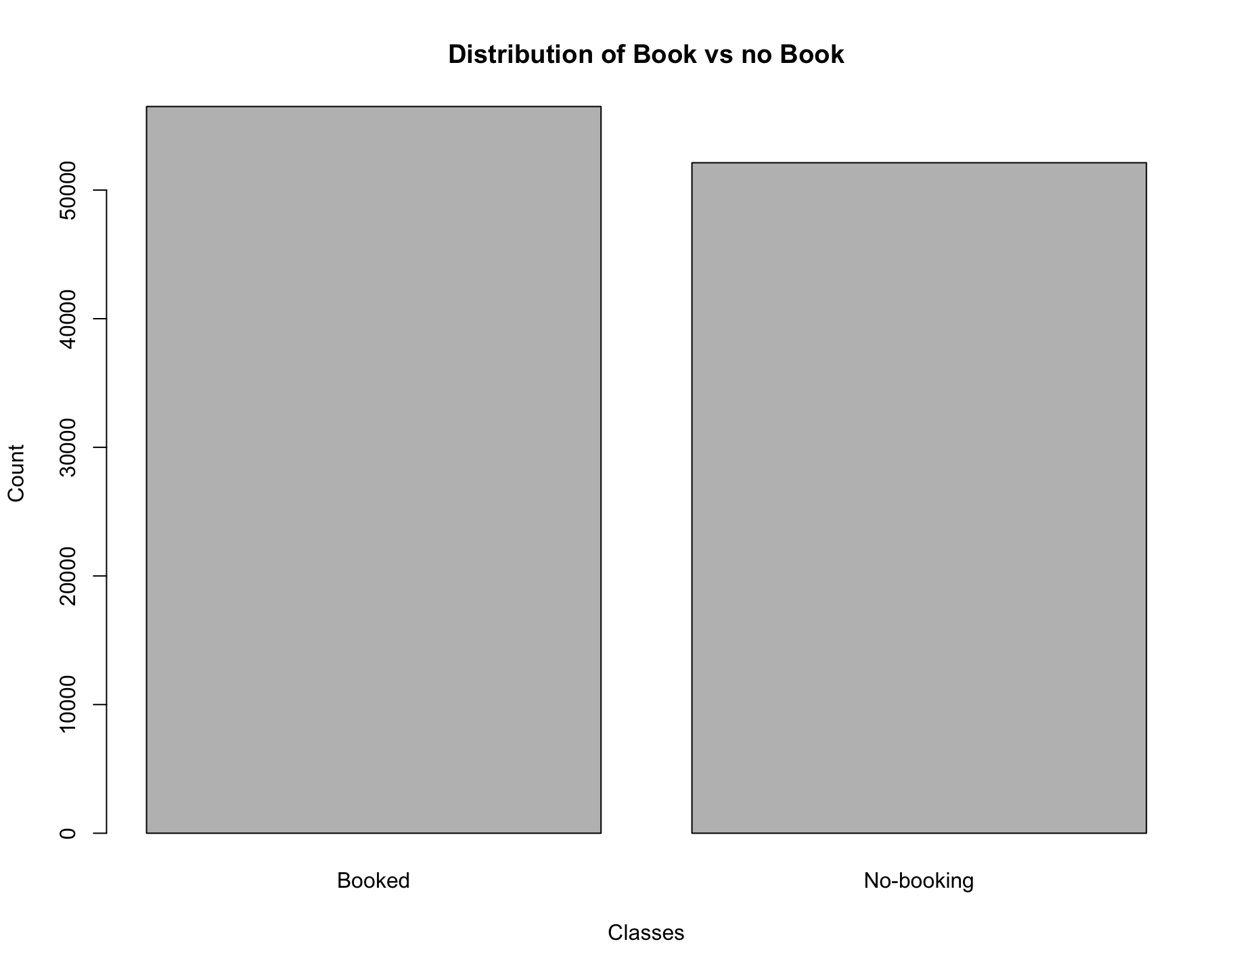
Level - 1 Prediction - Booking / No Booking?
At level 1 we’ve built 4 models to predict weather an user is going to make a booking or not with below accuracies
Model | Accuracy
Logistic Regression | 0.6202
Random Forest | 0.6227
Naïve Bayes | 0.6181
XGBoost | 0.6222

Slide 9
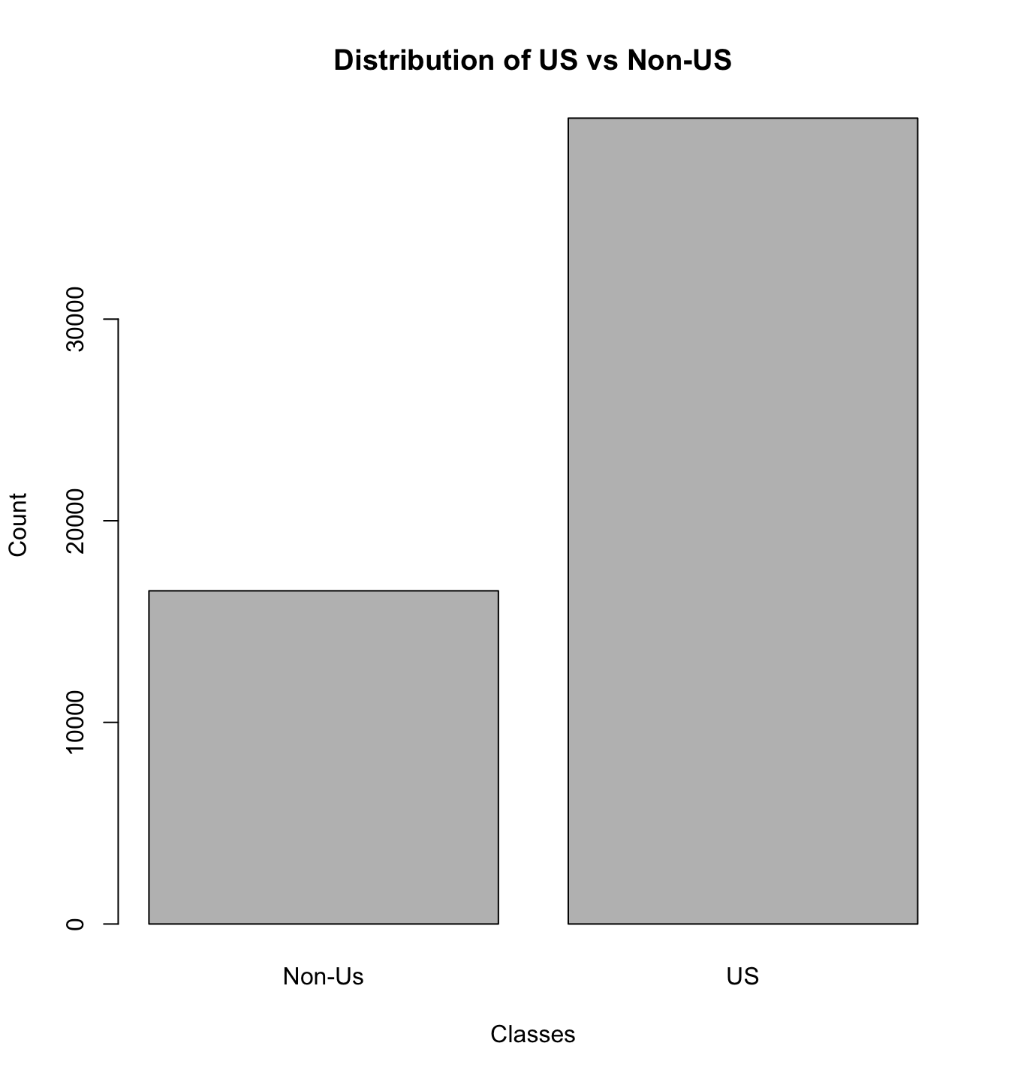
Level - 2 Prediction - US/Non US destination?
At level 2 we’ve built 4 models to predict whether a user is going to choose US or non-US destination given that they are predicted to be going for a booking.
Model | Accuracy
Logistic Regression | 0.7078
Random Forest | 0.7072
Naïve Bayes | 0.7072
XGBoost | 0.7060

Slide 10
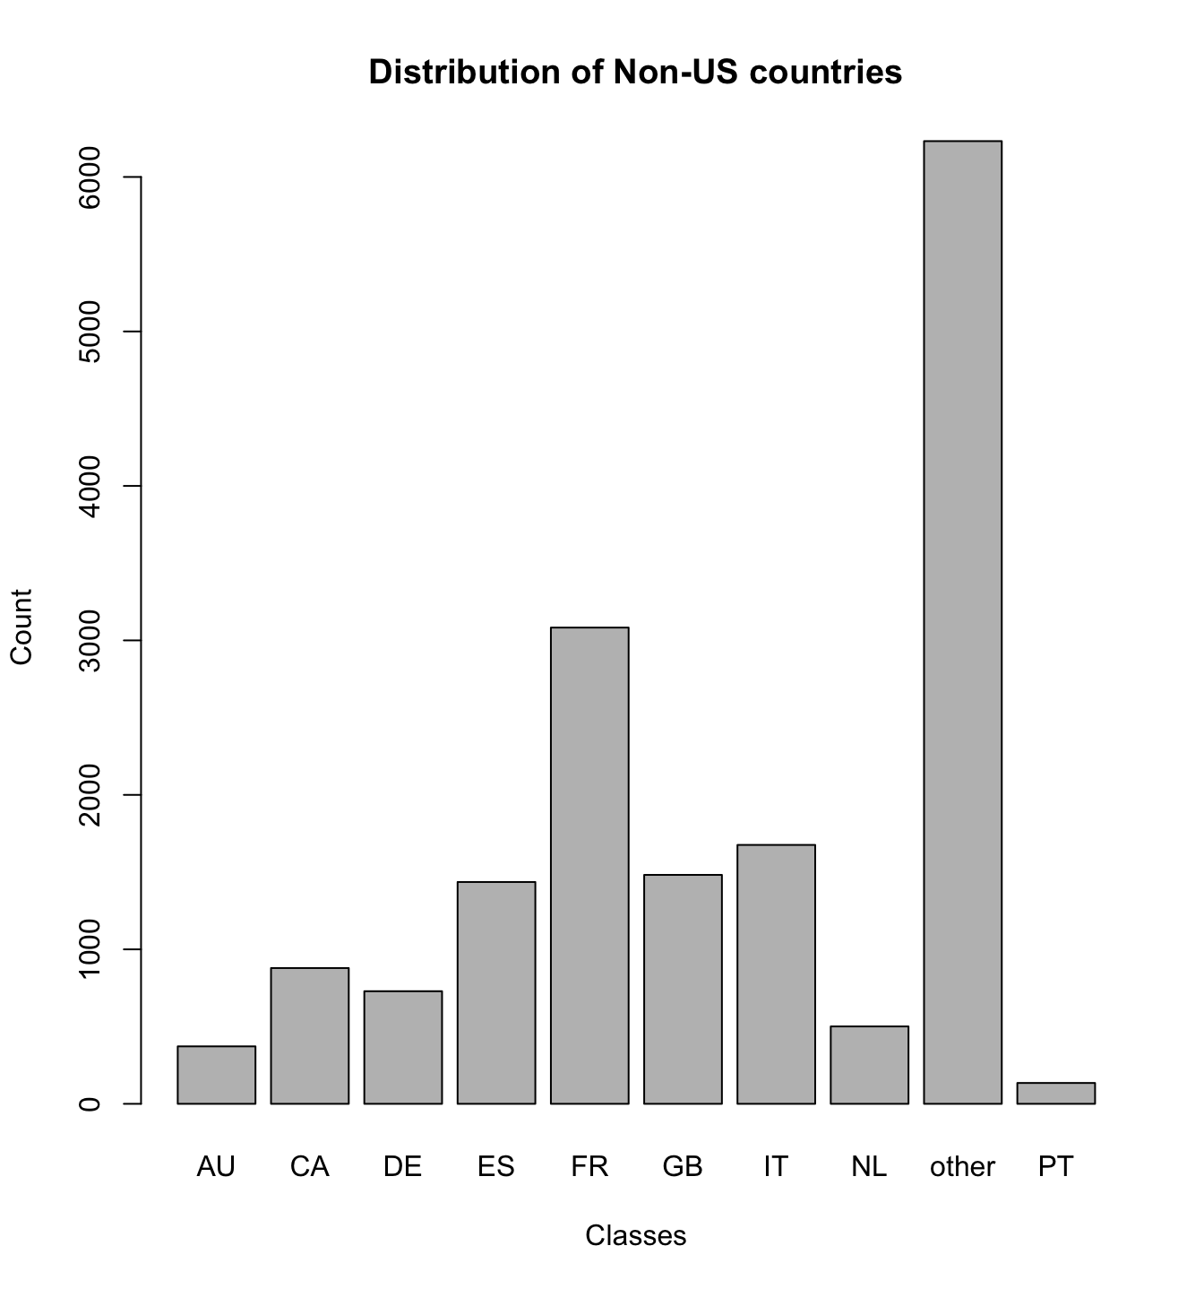
Level - 3 Prediction - Which Non-US country?
At level 3 our decision is no longer a binary. Instead we need to predict multiple classes.
For this purpose we used multinomial logistic regression model with accuracy of 0.3825
We expect the accuracy to be low considering the the level of unbalanced classes and limited records.
Model can be trained better if we can have more records.

Slide 11
Thank You!

